Slide 1
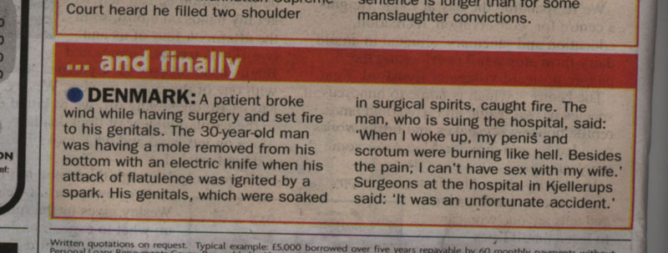
Methane Gas Combustion
An Exothermic Reaction
CH₄ + O₂ → CO₂ + H₂O

